Slide 1


Radial Basis Function Networks

Slide 2
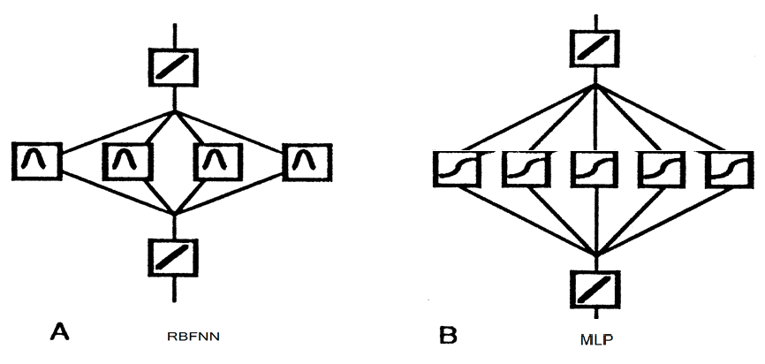
RBFNN vs MLP

Slide 3
Radial Basis Function Network
introduction
A kind of supervised neural networks
Design of NN as curve-fitting problem
Learning
find surface in multidimensional space best fit to training data
Generalization
Use of this multidimensional surface to interpolate the test data

Slide 4
Radial Basis Function Network
introduction
Approximate function with linear combination of Radial basis functions
F(x) = Σ w_{i} h(x)
h(x) is mostly Gaussian function

Slide 5
architecture
x₁
h₁
W₁
h₂
x₂
W₂
h₃
x₃
W₃
f(x)
W_{m}
x_{n}
h_{m}
Input layer
Output layer

Slide 6
Three layers
architecture
Input layer
Source nodes that connect to the network to its environment
Hidden layer
Hidden units provide a set of basis function
High dimensionality
Output layer
Linear combination of hidden functions

Slide 7
Radial basis function
architecture
m
f(x) = ∑ w_{j}h_{j}(x)
j=1
h_{j}(x) = exp( -(x-c_{j})² / r_{j}² )
Where c_{j} is center of a region,
r_{j} is width of the receptive field

Slide 8
In MLP
introduction
(sigmoid)

Slide 9
In RBFN
introduction
(gaussian)

Slide 10
Gaussian RBF φ
φ :
center
σ is a measure of how spread the curve is:
Large σ
Small σ

Slide 11
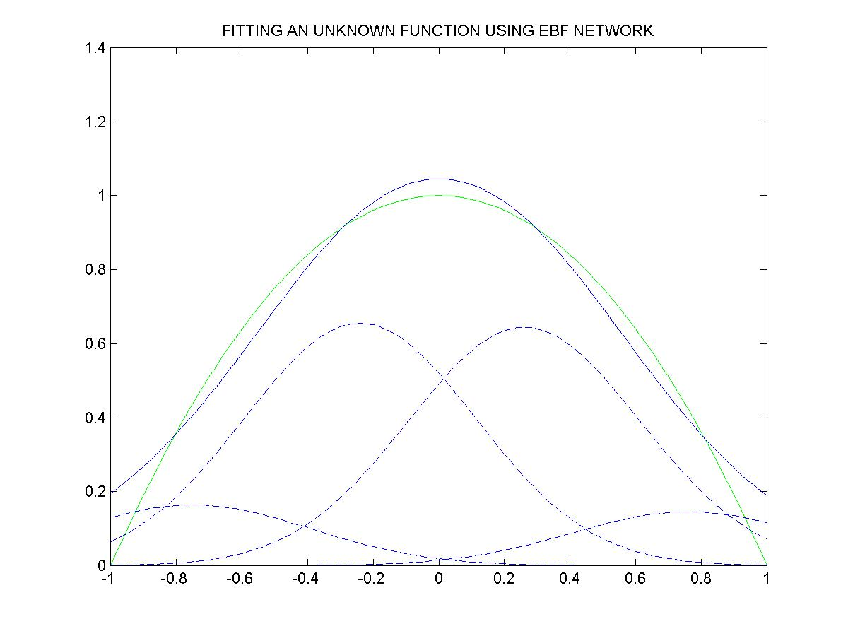
RBF network fits an unknown function
Solid green curve: Target function – y = 1-x²
Solid blue curve: Network output
Dashed blue:
4 Gaussians

Slide 12
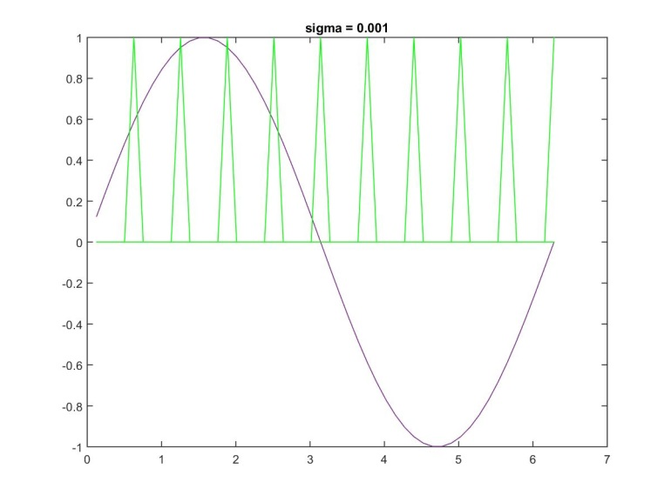
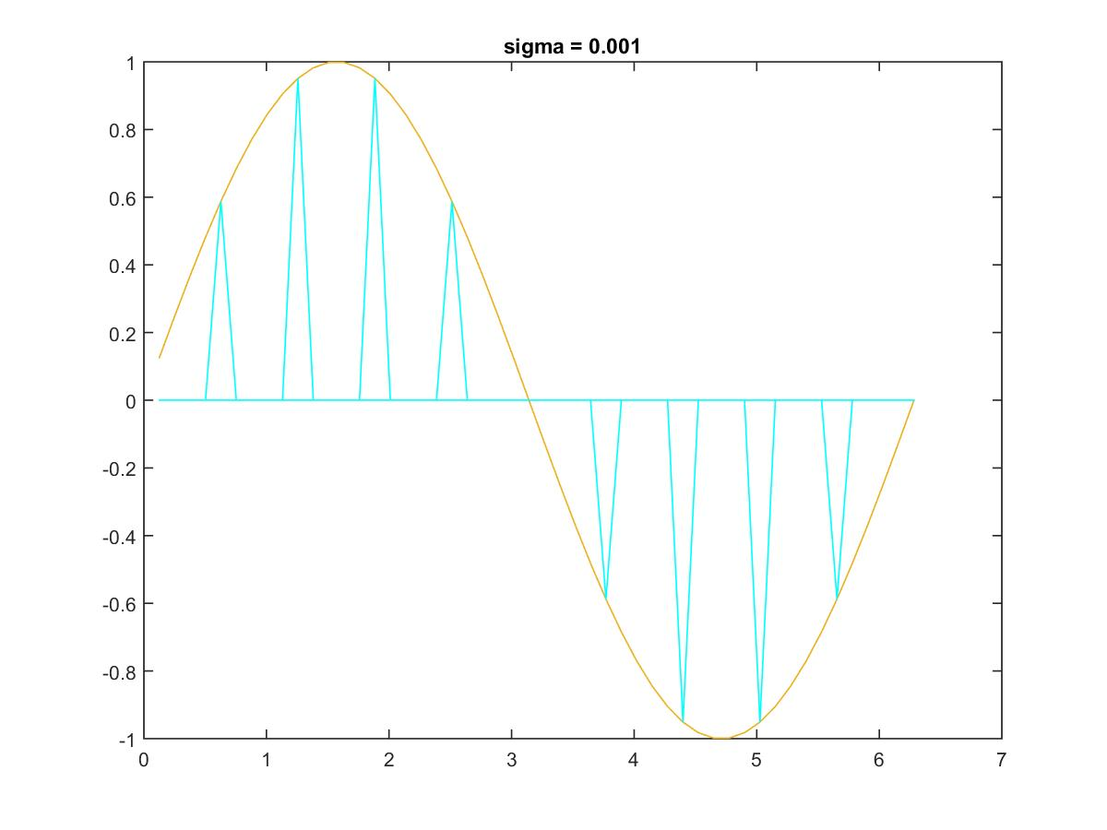
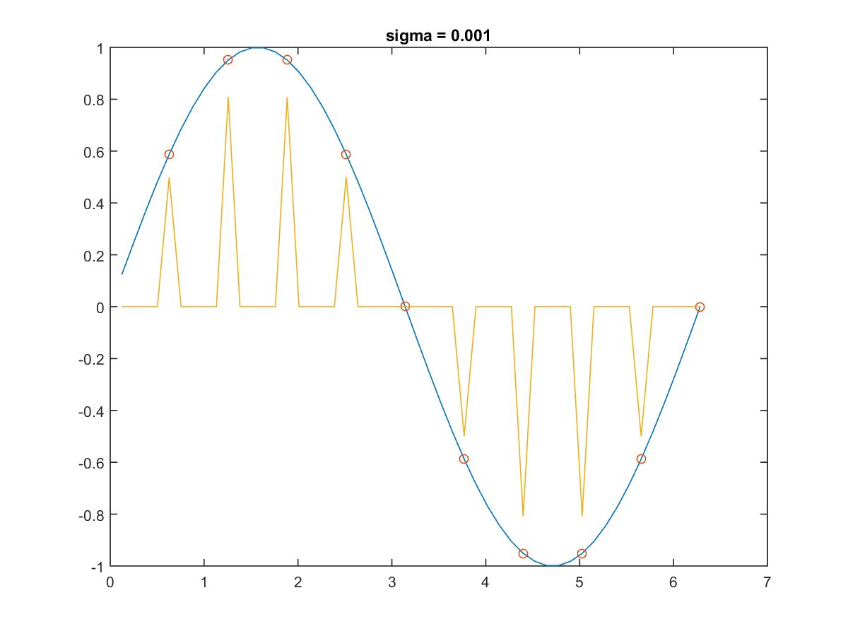
Fitting a curve using RBFNN
Sigma=0.001
Individual
Gaussians
Individual
Gaussians
With weights
Network output =
Weighted sum of
Gaussians

Slide 13
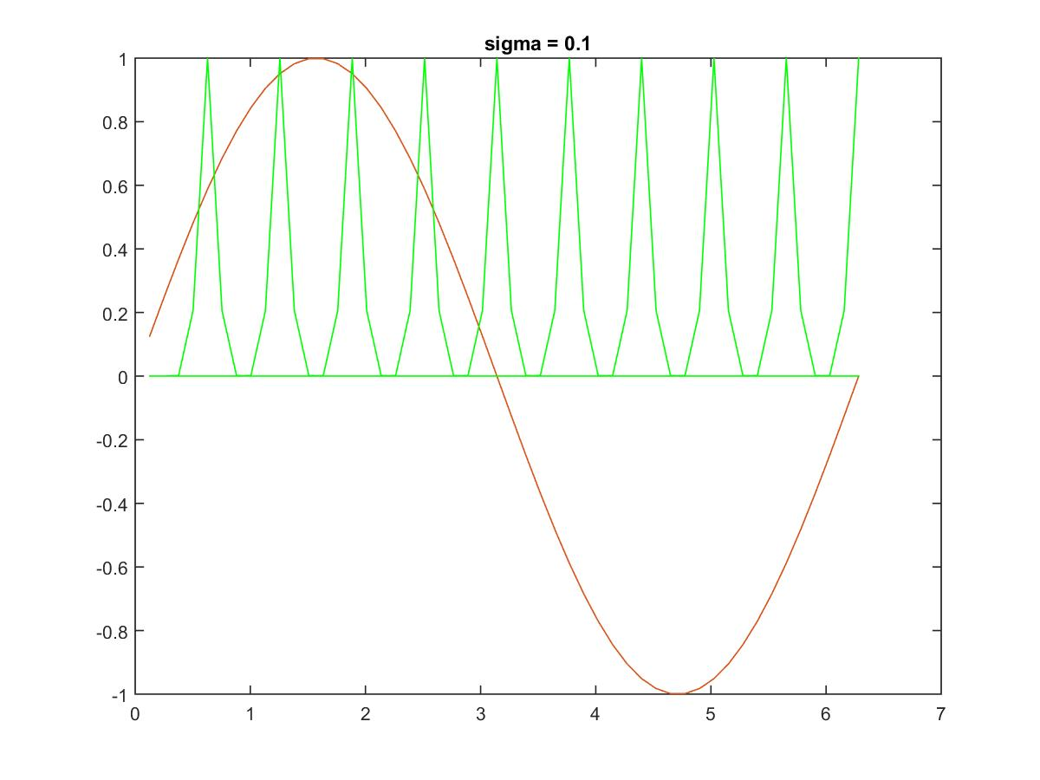
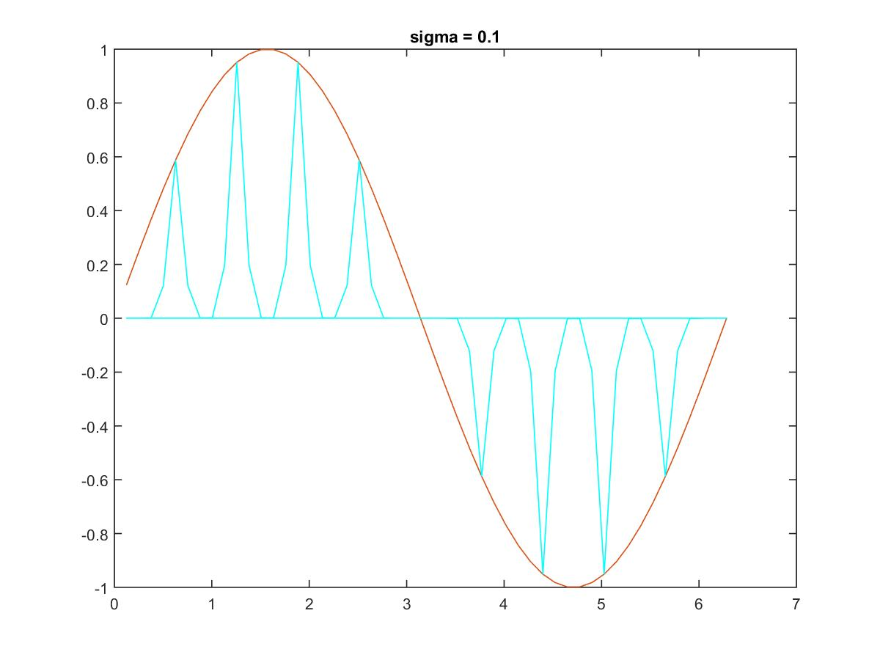
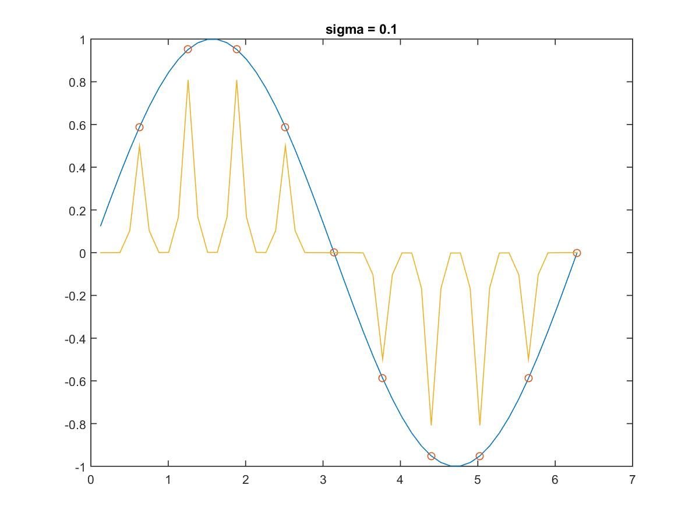
Sigma=0.1

Slide 14
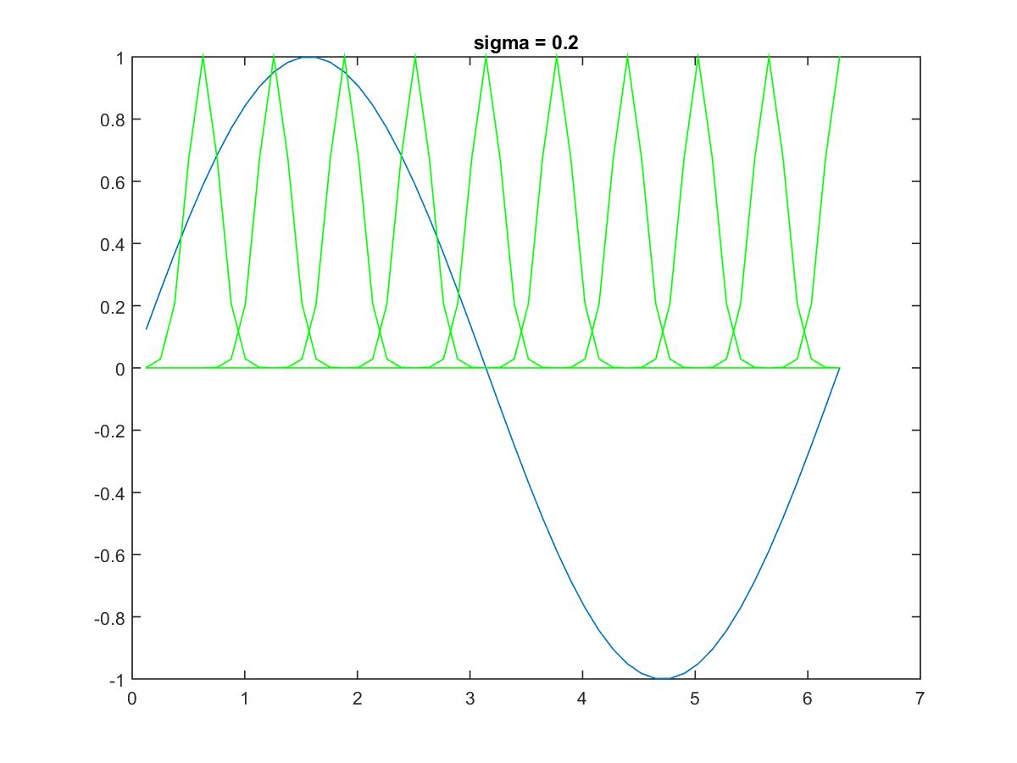
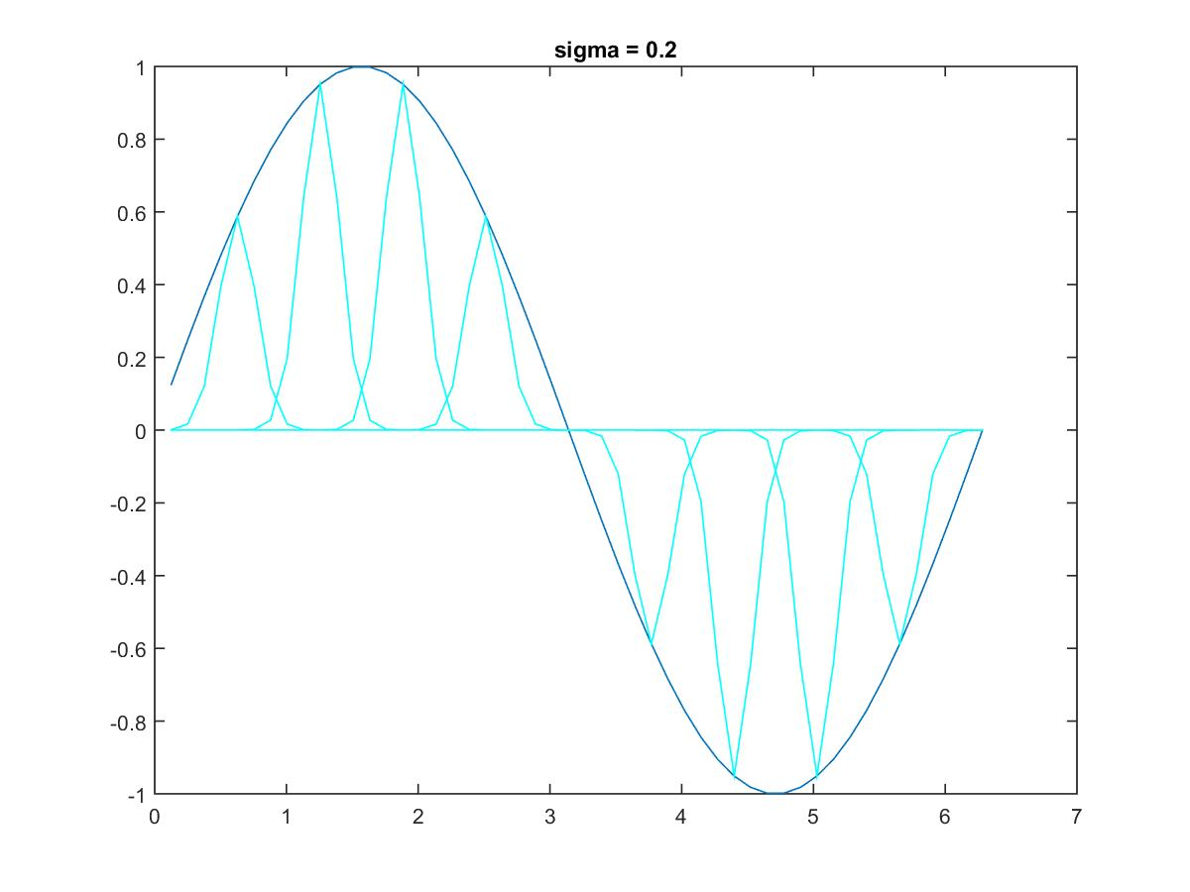
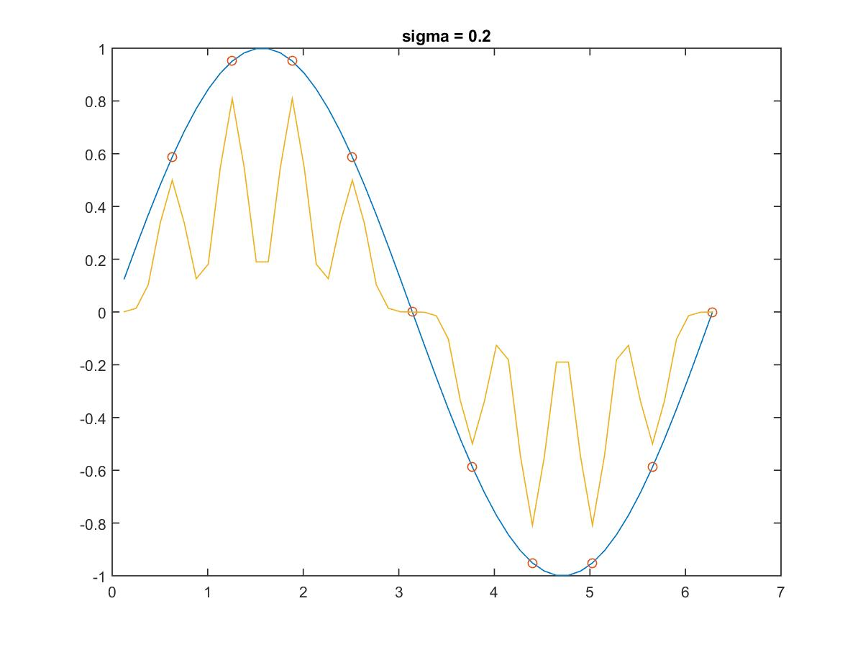
Sigma=0.2

Slide 15
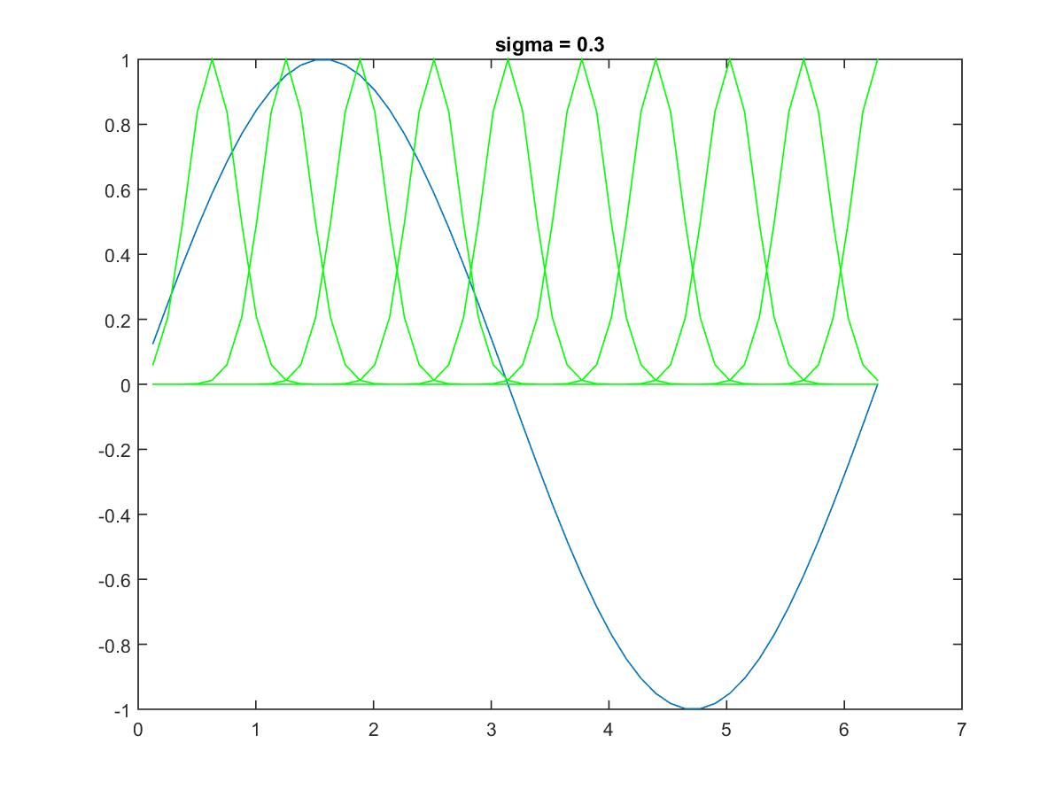

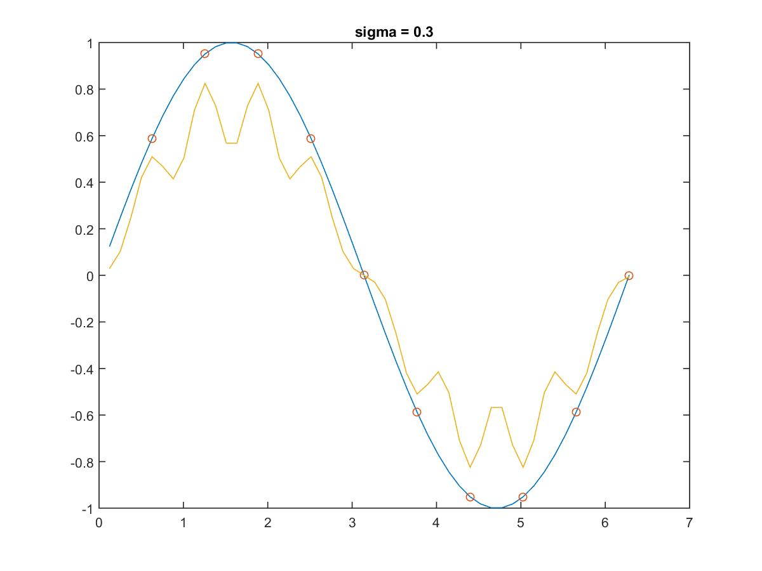
Sigma=0.3

Slide 16
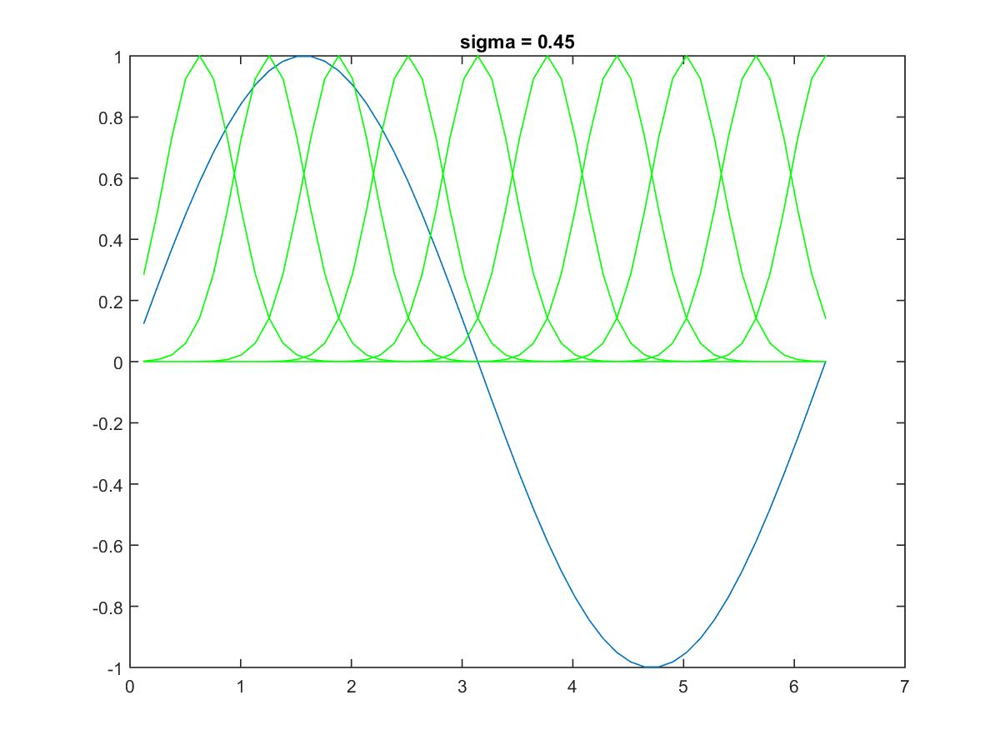

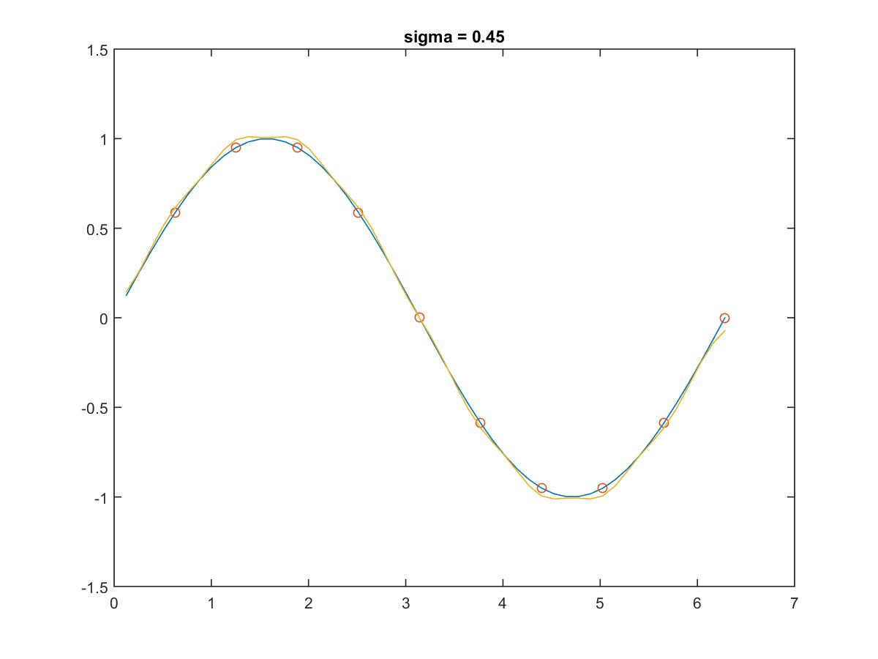
Sigma=0.45

Slide 17
Types of φ
Multiquadrics:
Inverse multiquadrics:
Gaussian functions (most used):

Slide 18
Example: the XOR problem
x₂
Input space:
Output space:
Construct an RBF pattern classifier such that:
(0,0) and (1,1) are mapped to 0, class C1
(1,0) and (0,1) are mapped to 1, class C2
(0,1)
(1,1)
x₁
(0,0)
(1,0)
0
1
y

Slide 19
Example: the XOR problem
In the feature (hidden layer) space:
When mapped into the feature space < ϕ₁ , ϕ₂ > (hidden layer), C1 and C2 become linearly separable. So a linear classifier with ϕ₁(x) and ϕ₂(x) as inputs can be used to solve the XOR problem.
φ₂
(0,0)
Decision boundary
1.0
0.5
(1,1)
0.5
1.0
φ₁
(0,1) and (1,0)

Slide 20
RBF NN for the XOR problem
x₁
t1
-1
y
x₂
t2
-1
+1

Slide 21
RBF network parameters
What do we have to learn for a RBF NN with a given architecture?
The centers of the RBF activation functions
the Widths of the Gaussian RBF activation functions
the weights from the hidden to the output layer
Different learning algorithms may be used for learning the RBF network parameters. We describe three possible methods for learning centers, spreads and weights.

Slide 22
Learning Algorithm 1
Centers: are selected at random
centers are chosen randomly from the training set
Spreads: are chosen by normalization:
Then the activation function of hidden neuron becomes:

Slide 23
Learning Algorithm 1
Weights: are computed by means of the pseudo-inverse method.
For an example consider the output of the network
We would like for each example, that is

Slide 24
Learning Algorithm 1
This can be re-written in matrix form for one example
and
for all the examples at the same time

Slide 25
Learning Algorithm 1
let
then we can write
If is the pseudo-inverse of the matrix we obtain the weights using the following formula

Slide 26
Interpolation Theorem (Michelli 1986)
Let x_{i} (i =1,N) be a set of distinct points in R^{n}. Then the N x N interpolation matrix φ, whose ij’th element is φ_{ij} = φ(||x_{i} – x_{j}||) is nonsingular.
(Put one Gaussian on every data point)

Slide 27
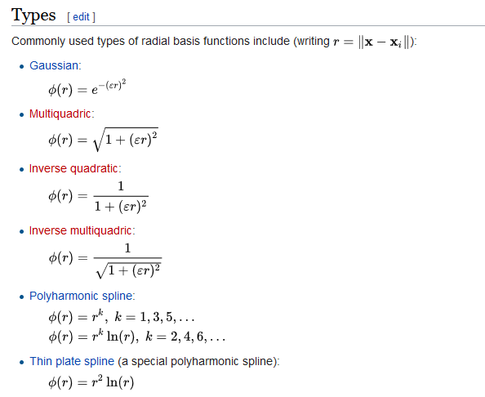
Radial Basis Functions

Slide 28
Learning Algorithm 1: summary

Slide 29
Learning Algorithm 2: summary
Hybrid Learning Process:
Clustering for finding the centers.
K-means clustering
Widths chosen by P-nearest neighbor distance.
LMS algorithm (see Adaline) for finding the weights.

Slide 30
Learning Algorithm #3: Gradient descent over output error
learning strategies
All free parameters of the network are changed by supervised learning process.
Error-correction learning using LMS algorithm.

Slide 31
Learning formula
learning strategies
Linear weights (output layer)
Positions of centers (hidden layer)
Spreads of centers (hidden layer)

Slide 32
MLP vs RBFN
Global hyperplane | Local receptive field
EBP | LMS
Local minima | Serious local minima
Smaller number of hidden neurons | Larger number of hidden neurons
Shorter computation time | Longer computation time
Longer learning time | Shorter learning time

Slide 33
Extensions
Elliptical Basis Functions
Links to Gaussian Mixture Models
Resource Allocation Network (Platt 1991)
Dynamic allocation of RBFs

Slide 34
Approximation
MLP vs RBFN
MLP : Global approximation
Inputs from half of the input space produce response
RBF : Local approximation
Only inputs near a receptive field produce an activation
Can give “don’t know” output

